Slide 1
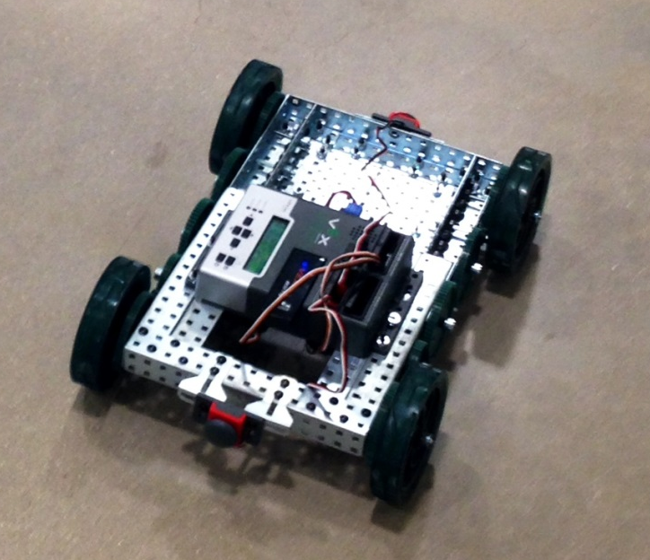
Harold’s Mechanics
Embedded Systems Fall 2013
Iteration 1
Jenny Reiman
Jason Laqua
Andrew Kirkham

Slide 2
Problem Statement
Entire Project: The objective of this project is to build and drive a robot around the central mall by using GPS programmed coordinates through a wireless connection to android devices.

Slide 3
Problem Statement
Iteration 1: The goal of the first iteration was to build the robot, drive forward/back/turn, avoid obstacles, and achieve communication with various devices

Slide 4
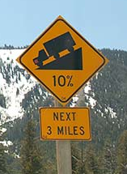

What was done
Robot was built
Robot drives and avoids obstacles
10% grade was tested
Android to Android (UDP)
Communication between clients and servers
Emergency Stop Button

Slide 5

What Worked
Moving forward/backwards and turning
Robot can climb 10% grade
Bumper sensors
Communication to Vex

Slide 6

What Didn’t Work
Battery Drainage – every iteration of testing left dead batteries
Robot Structure – Loose nuts cause the structure to be unstable
Android Communication: Unstable for TCP/IP
Terk IDE – difficult to work with

Slide 7
Lessons Learned
Use lock nuts, especially with turning or moving parts
Use UDP
USB power > batteries
Helper functions for libqwerk

Slide 8

Questions?

